Slide 1



INSTAGRAM USER ANALYTICS

Slide 2


PROJECT
DESCRIPTION
This project presents solution to the following needs and concerns of marketing and investors’ team:-
A) Marketing: The marketing team’s wish to launch some campaigns around the following:- Rewarding Most Loyal Users: People who have been using the platform for the longest time. Remind Inactive Users to Start Posting: By sending them promotional emails to post their 1st photo. Declaring Contest Winner: The team started a contest and the user who gets the most likes on a single photo will win the contest now they wish to declare the winner. Hashtag Researching: A partner brand wants to know, which hashtags to use in the post to reach the most people on the platform. Launch AD Campaign: The team wants to know, which day would be the best day to launch ADs.
B) Investor Metrics: The investors want to know if Instagram is performing well and is not becoming redundant like Facebook, they want to assess the app on the following grounds:- User Engagement: Are users still as active and post on Instagram or they are making fewer posts Bots & Fake Accounts: The investors want to know if the platform is crowded with fake and dummy accounts.

Slide 3
APPROACH
The approach to this project was kept very straight forward. The database was cautiously converted into an SQL tables to ensure most benefit from the database provided. After arranging the data various queries where raised to obtain desired output. Many times more than one table was used at a time to ensure complete and accurate results.

Slide 4
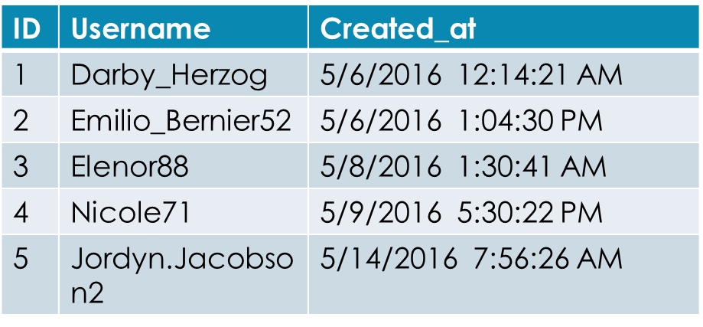
Tech-Stack Used:-
MySQL installer community 8.0.30.0.msi was used for this project it contains:- -MySQL Workbench 8.0 CE -MySQL Shell -MySQL Command Line Client​
Insight Following were the observations made from the results of various queries.​
The 5 oldest Instagram users are :-​

Slide 5
INSIGHTS
Insight Following were the observations made from the results of various queries.
The 5 oldest Instagram users are :-

Slide 6
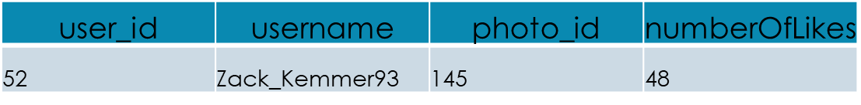
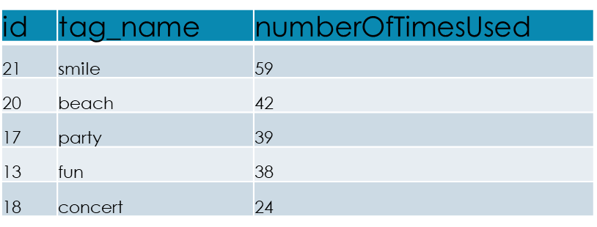
The inactive users of Instagram are:-
5 most commonly used hashtags:-

Slide 7
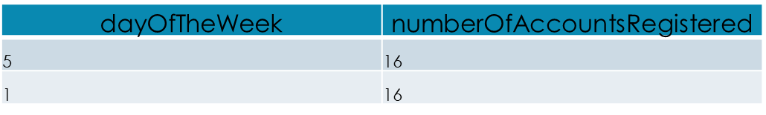
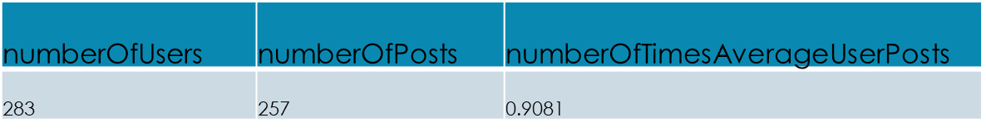
Best day to launch an AD campaign:-
Total number of users on Instagram, total number of posts on Instagram and number of times an average user posts on Instagram:-

Slide 8
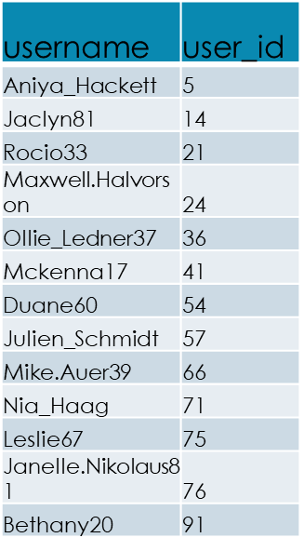
List of all the fake accounts on Instagram:-

Slide 9
RESULTS:
I have got much knowledge about creating database and about SQL & I also got knowledge about marketing techniques

Slide 10
DRIVE LINK:
https://drive.google.com/drive/folders/1oWzehcmBAw24YIhB5fuqc-_W_CH-pWi4?usp=share_link

Slide 11


